Slide 1


Dynamic Documentation Generation and Crowdsourcing in SasView
Brayden Miller - Albert Einstein High School
Mentor: Dr. Paul Butler

Slide 2
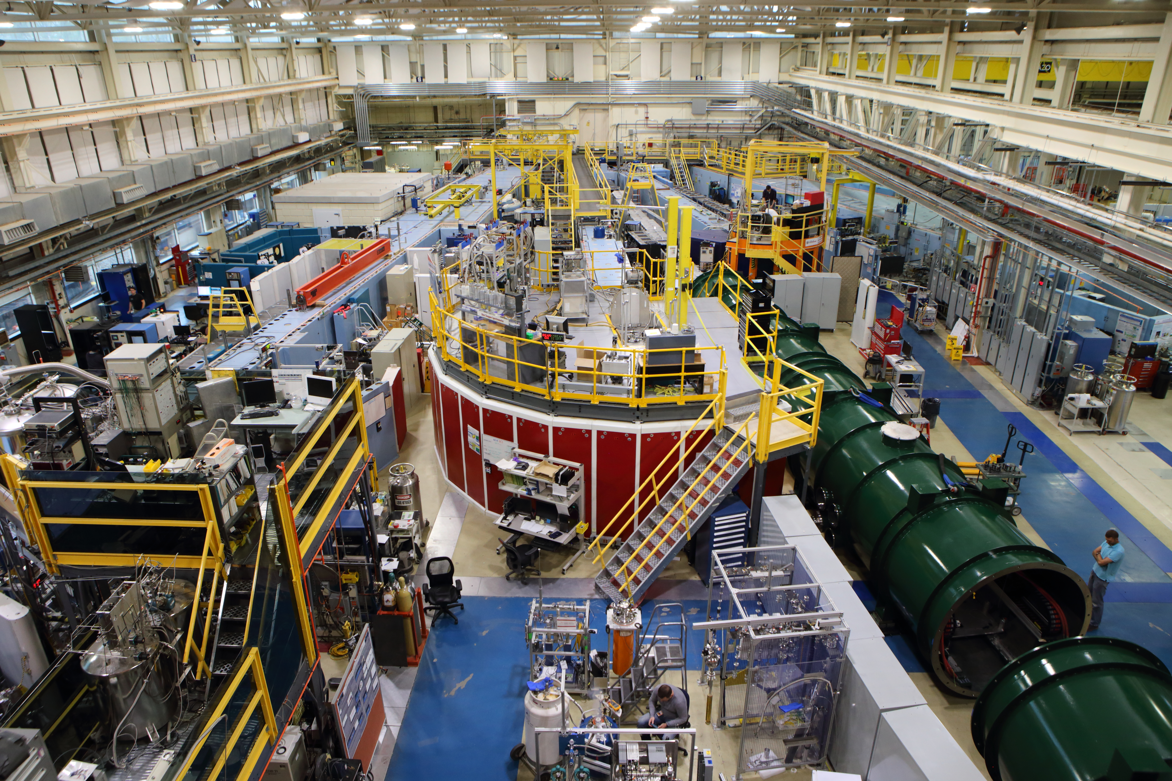
Our Facility
A nuclear reactor
A variety of instruments
“NCNR East Guide Hall.” NIST, April 17, 2017. https://www.nist.gov/image/20170417016guidehalljpg.

Slide 3

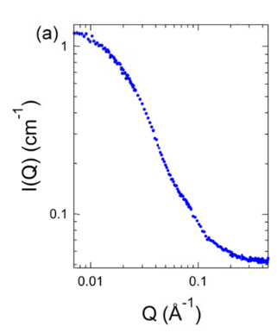
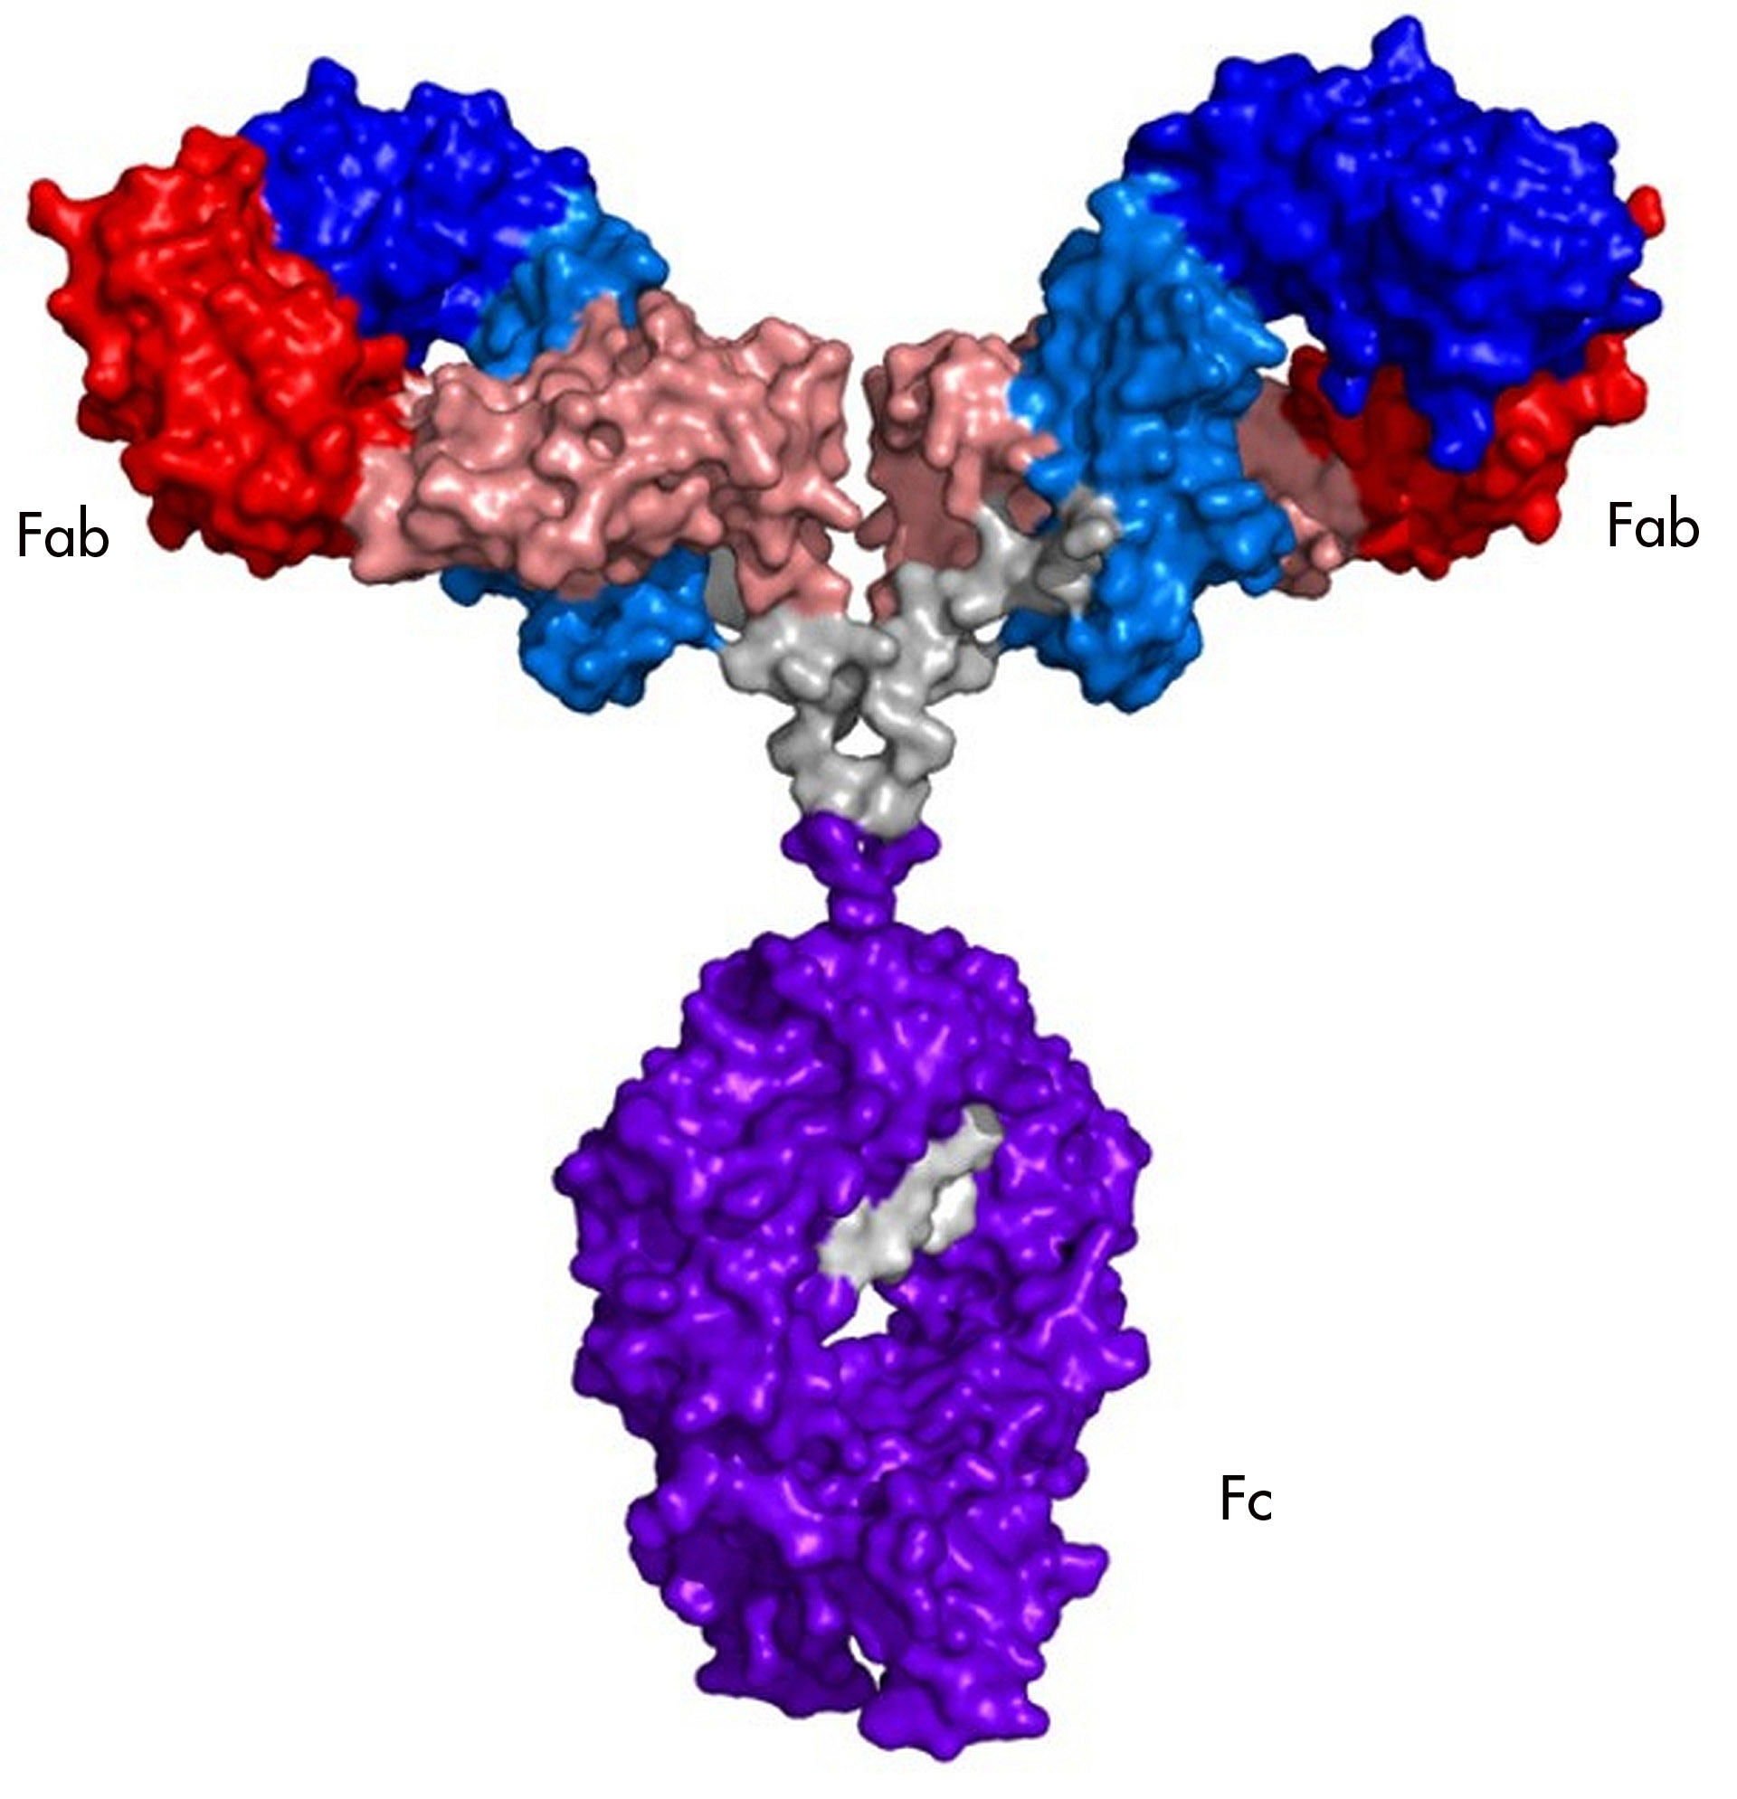

Background: What is SANS?
?
NEUTRONS
DATA
What does a molecule look like?
Protein Image: “NIST 2D NMR ‘fingerprinting’ Study Gives Biopharmaceutical Sector New Power to Assure High Quality Monoclonal Antibody Therapeutics.” NIST, December 21, 2018. https://www.nist.gov/news-events/news/2018/12/nist-2d-nmr-fingerprinting-study-gives-biopharmaceutical-sector-new-power.
Detector
LOTS OF MATH
Yearley, Eric J., Isidro E. Zarraga, Steven J. Shire, Thomas M. Scherer, Yatin Gokarn, Norman J. Wagner, and Yun Liu. “Small-Angle Neutron Scattering Characterization of Monoclonal Antibody Conformations and Interactions at High Concentrations.” Biophysical Journal 105, no. 3 (August 6, 2013): 720–31. https://doi.org/10.1016/j.bpj.2013.06.043.

Slide 4
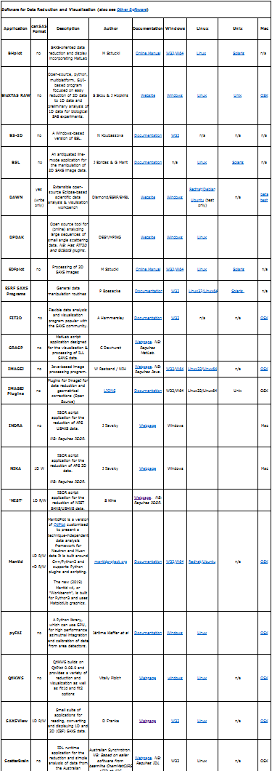
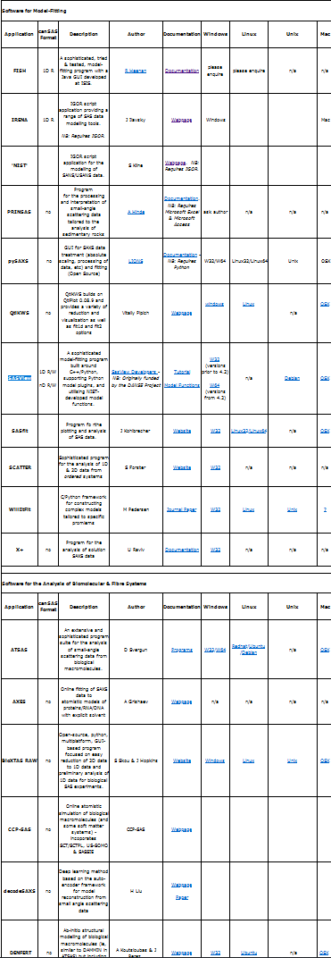
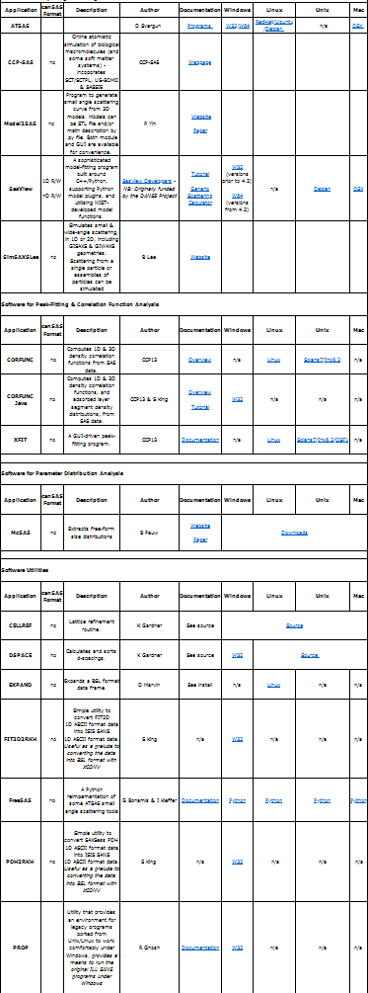
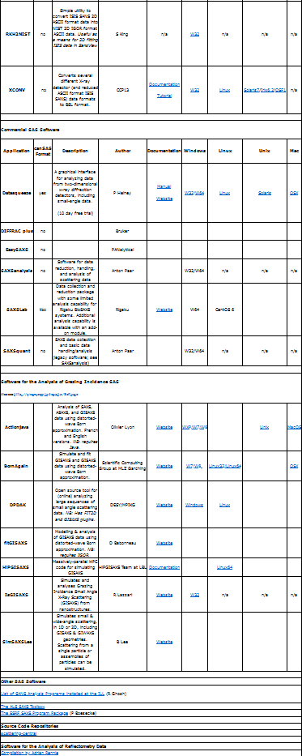
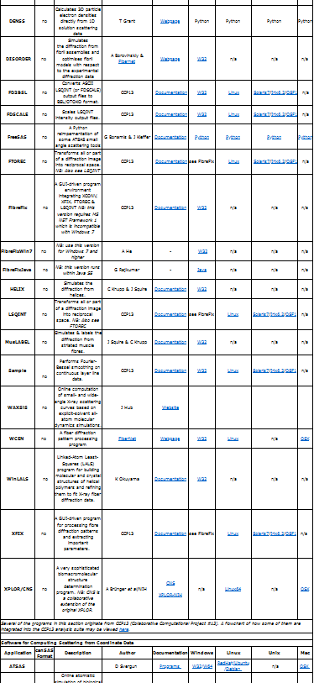

Analysis software—It does the math for us!
What makes SasView unique?
Capable of a wide variety of analysis operations
Extensive documentation ~140 Pages, some ~6,000 words
Maintained by community

Slide 5
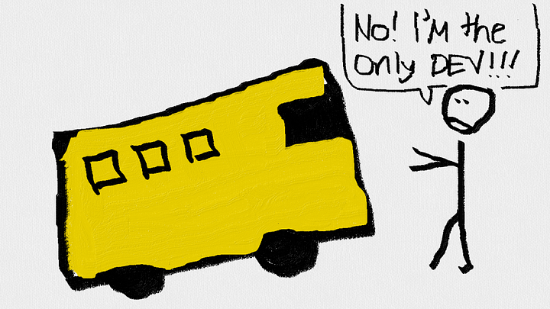
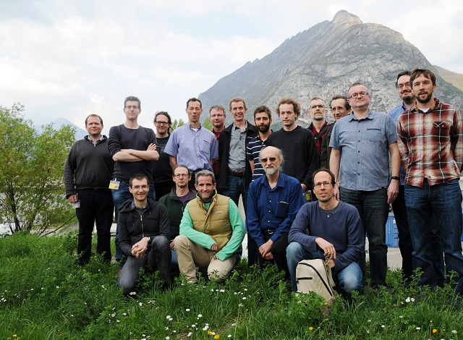
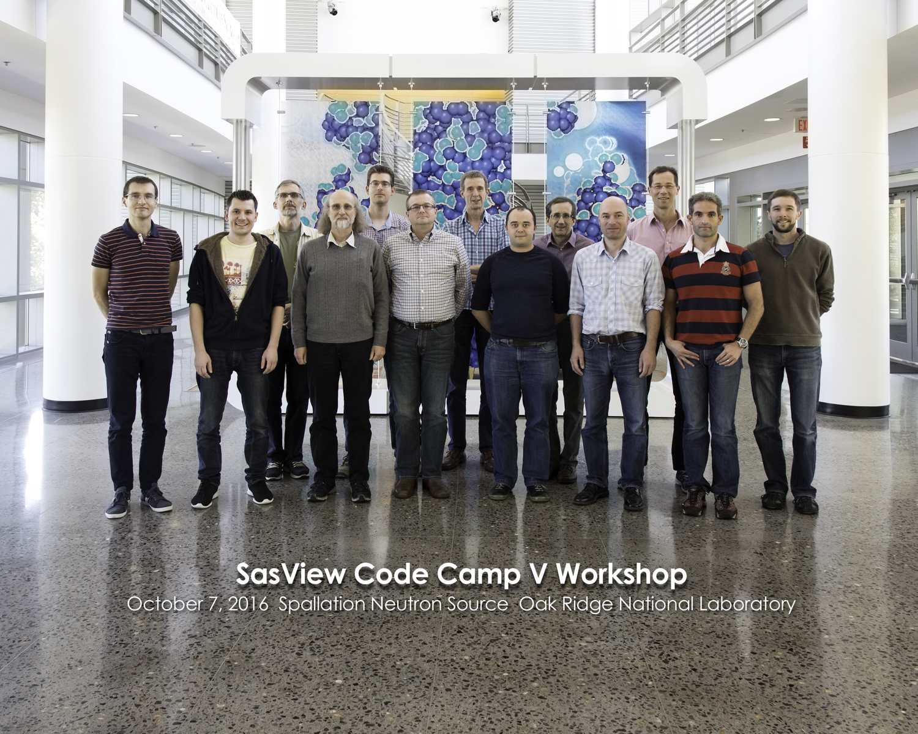
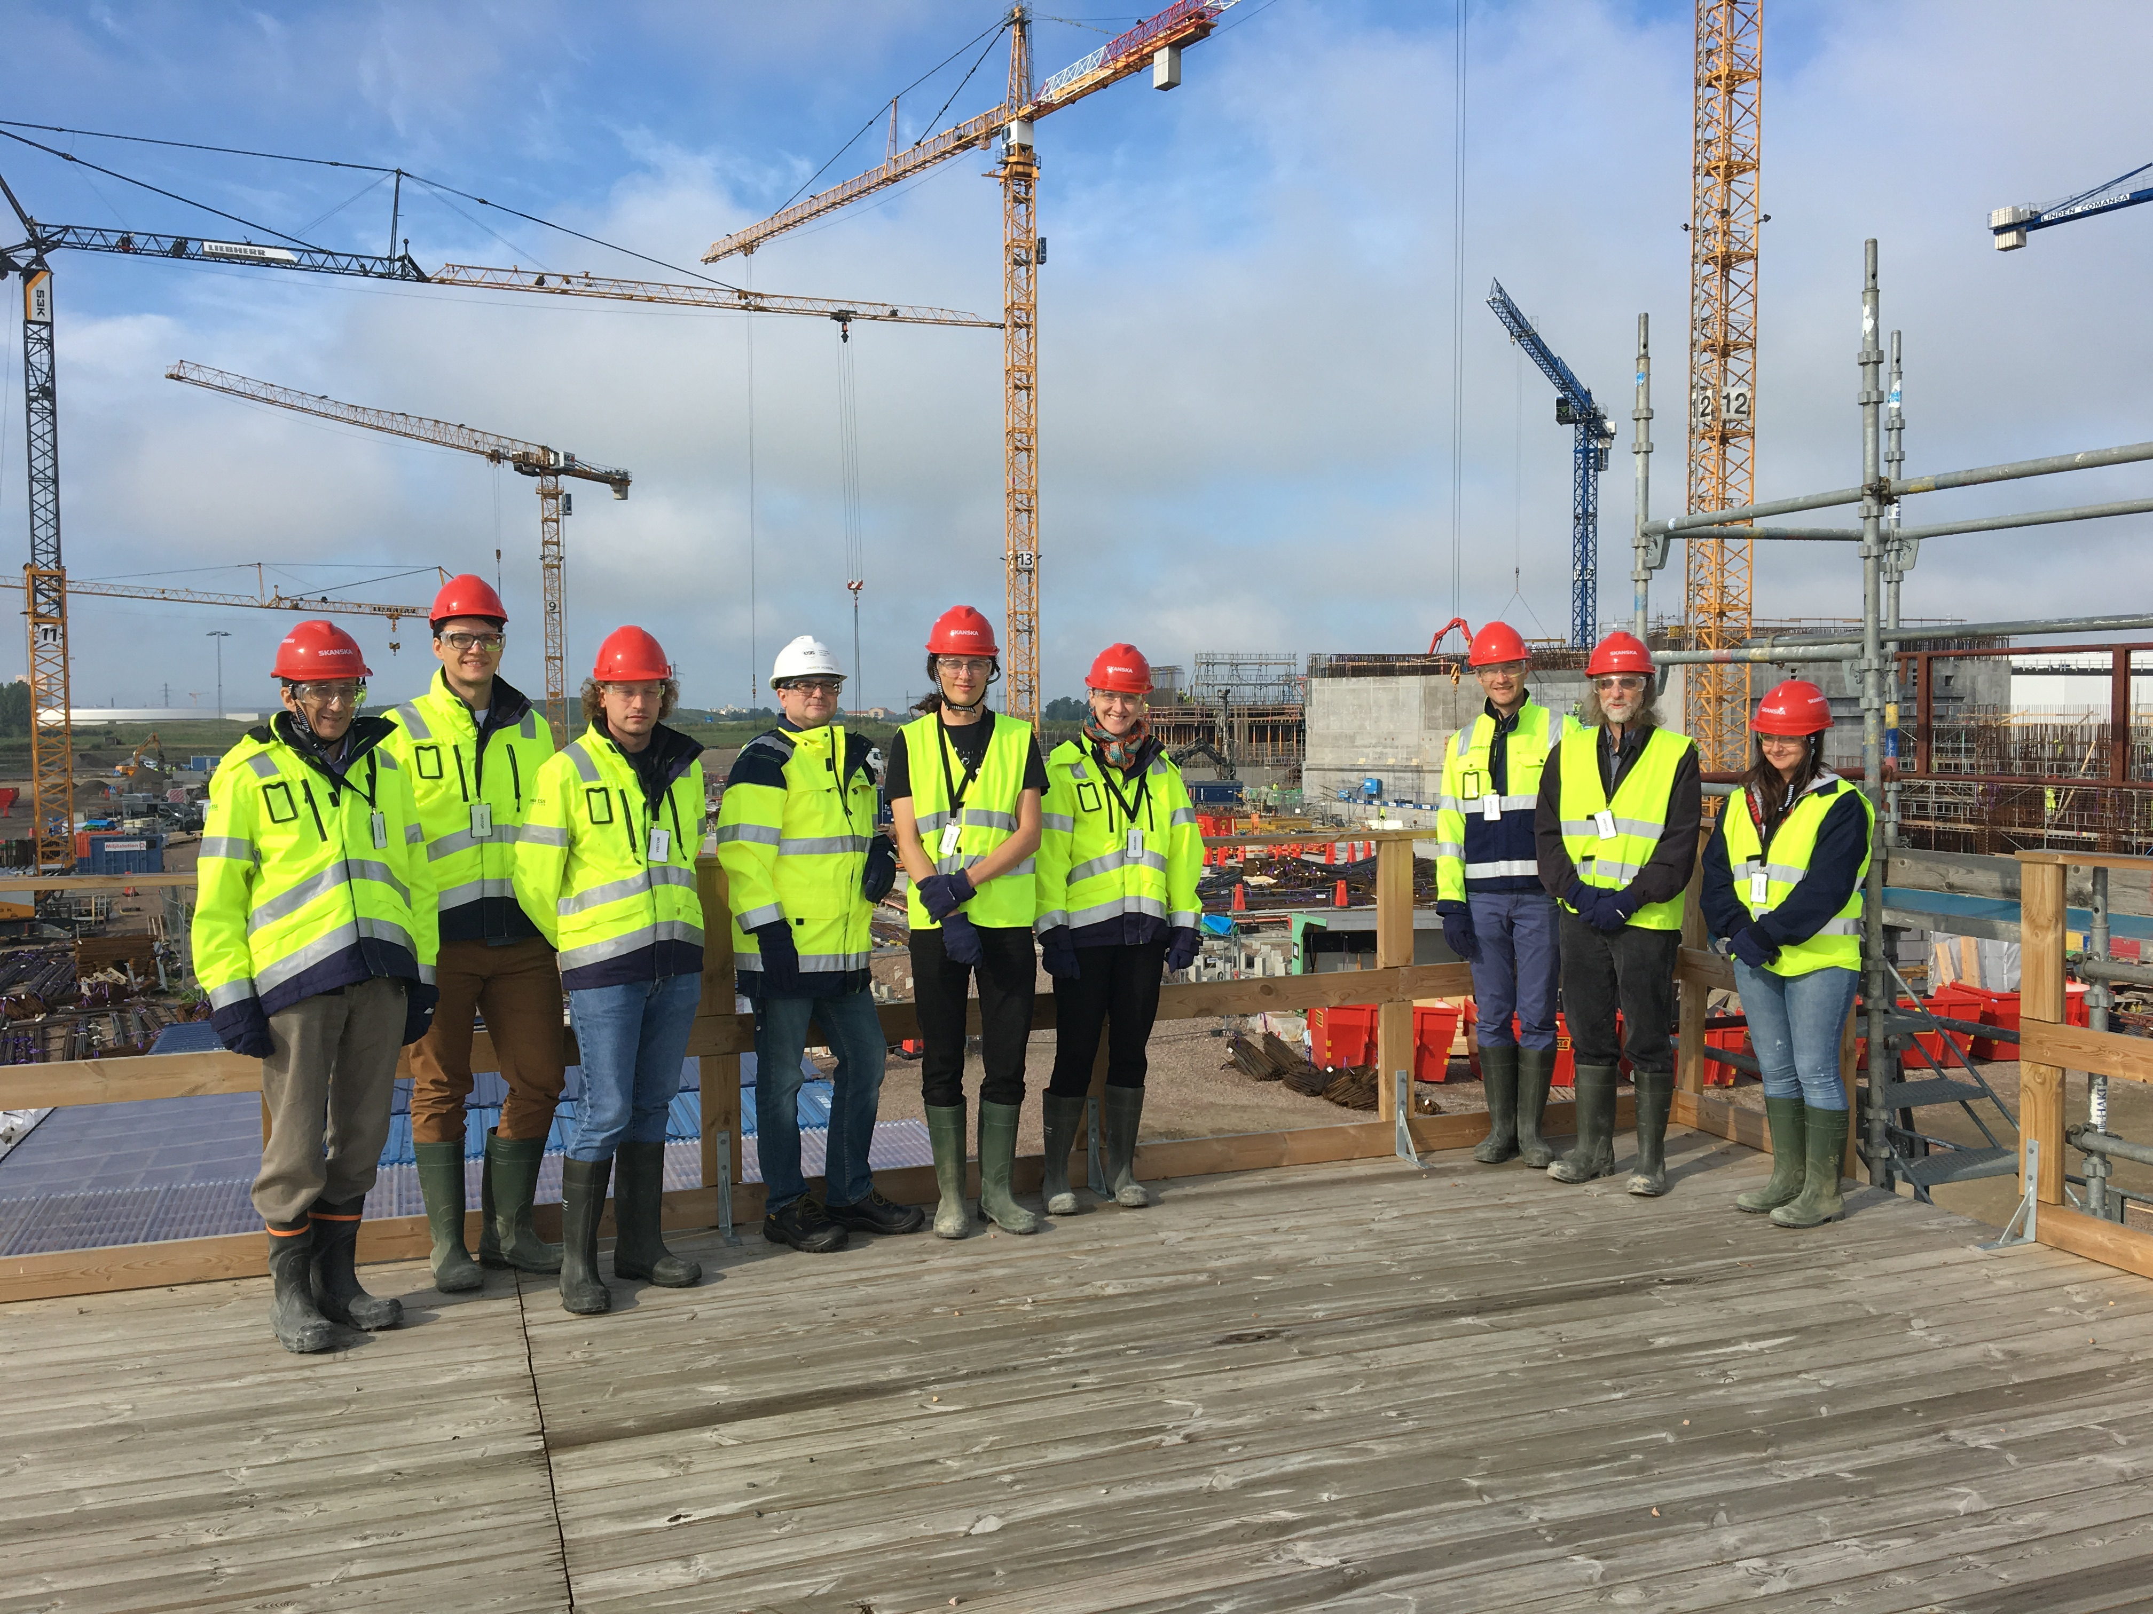










About the
community
An open-source, collaborative, & international project
Protected from the BUS FACTOR
Ahmed, Adnan. “The Bus Factor.” Tajawal (blog), May 4, 2018. https://medium.com/tech-tajawal/the-bus-factor-6ea1a3ede6bd.

Slide 6
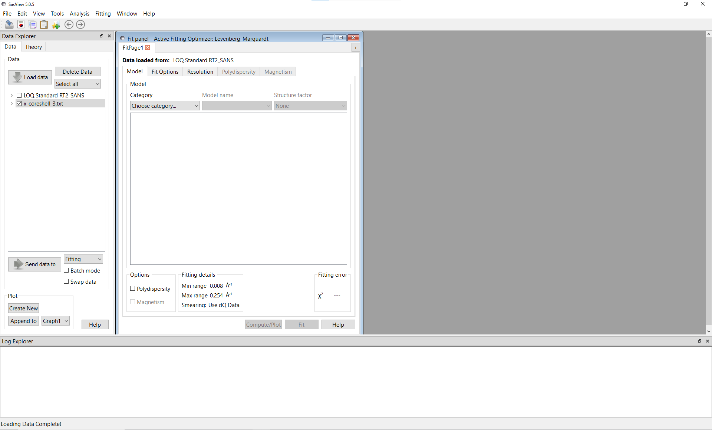
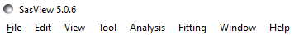
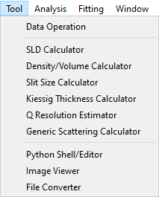
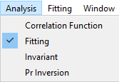
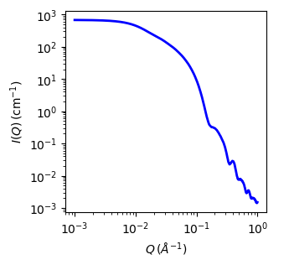
t₁
t₂
I = f(t₁ t₂)

Slide 7
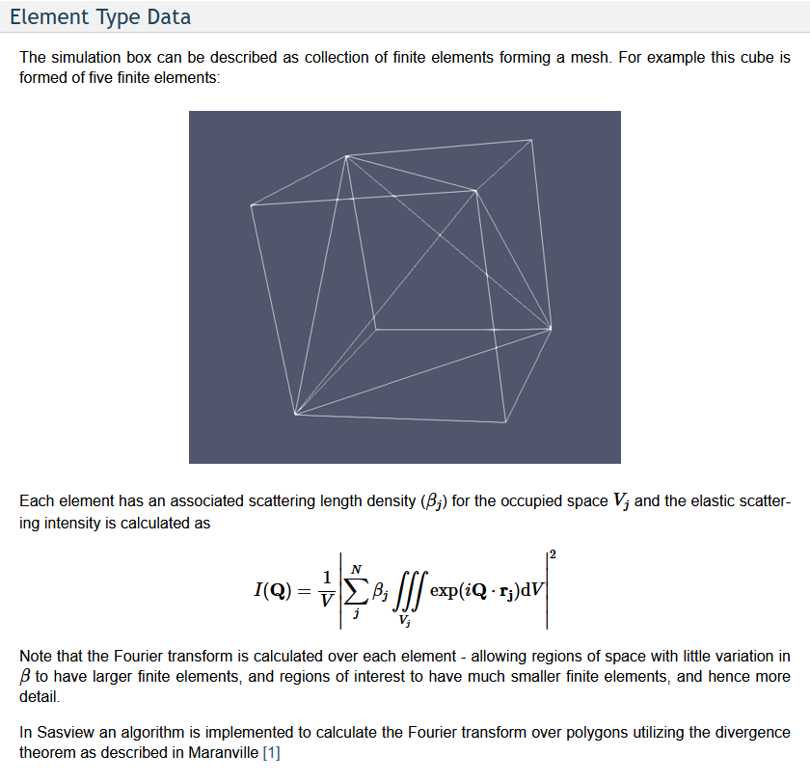
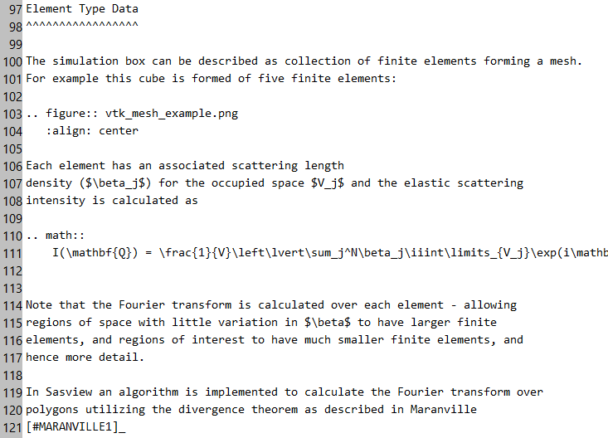
What does documentation look like?
What we write
What we see
Notes:
It’s important that as an application’s user base changes, it’s documentation can change with it

Slide 8
Documentation Problems:
Model
Documentation
Developer
What we write ✔️
What we see ❌
❌
User
What we write❌
What we see ✔️
Notes:
Although it’s possible to make documentation for community-based models, the above problems make it infinitely harder for the average user

Slide 9



Objective
Make changes to
ReST documentation
in SasView GUI editor
Functional
Easy to use
Minimal changes to code structure
View changes
in HTML
formatted docs
Submit corrected
ReST files
to developers

Slide 10
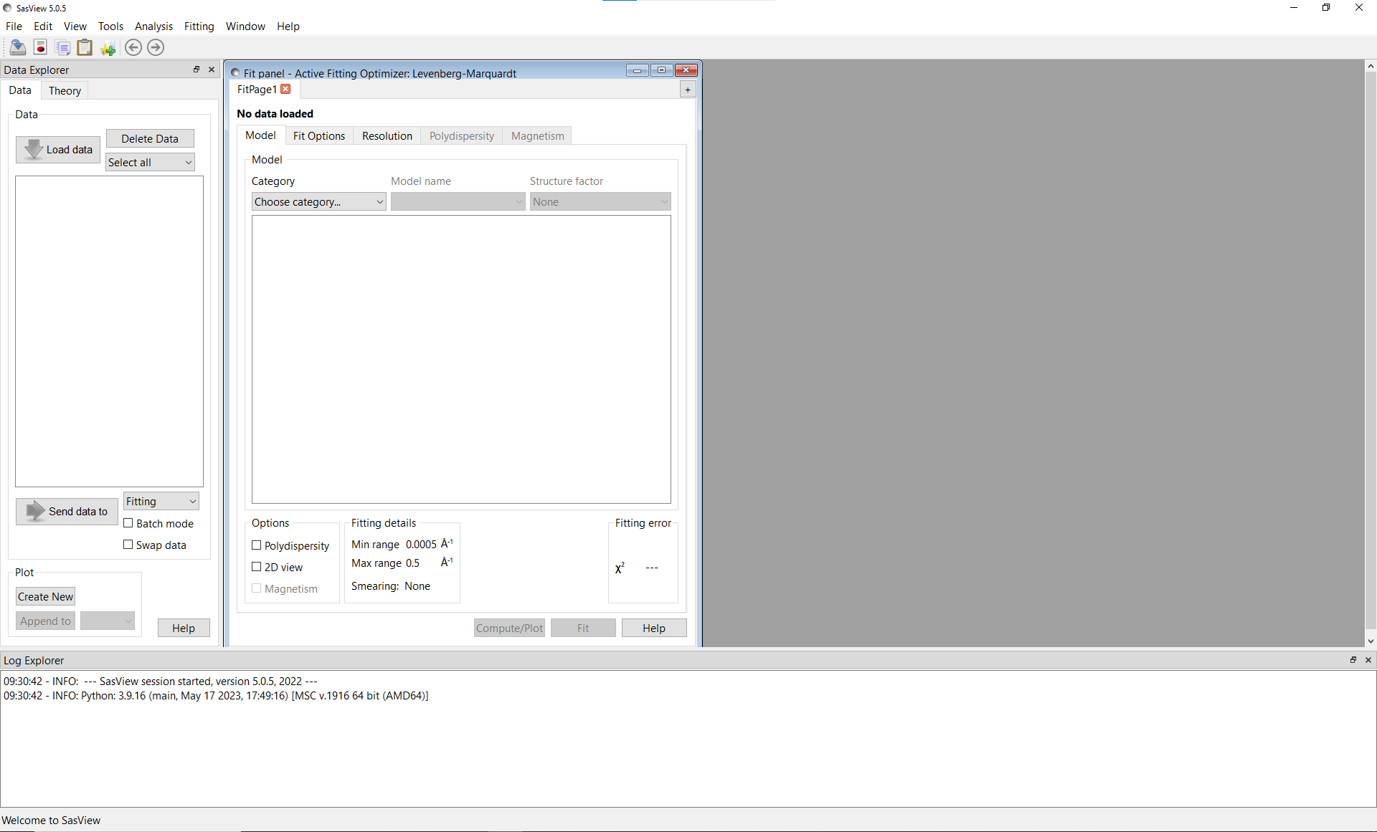
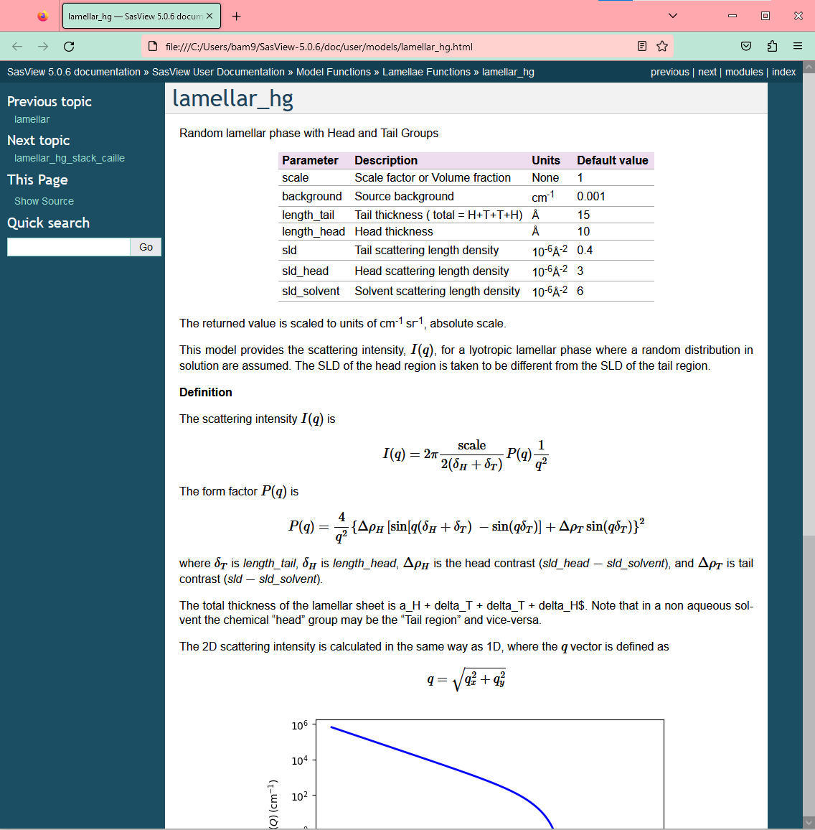
Restructuring changes
SasView
Web Browser
Old approach

Slide 11
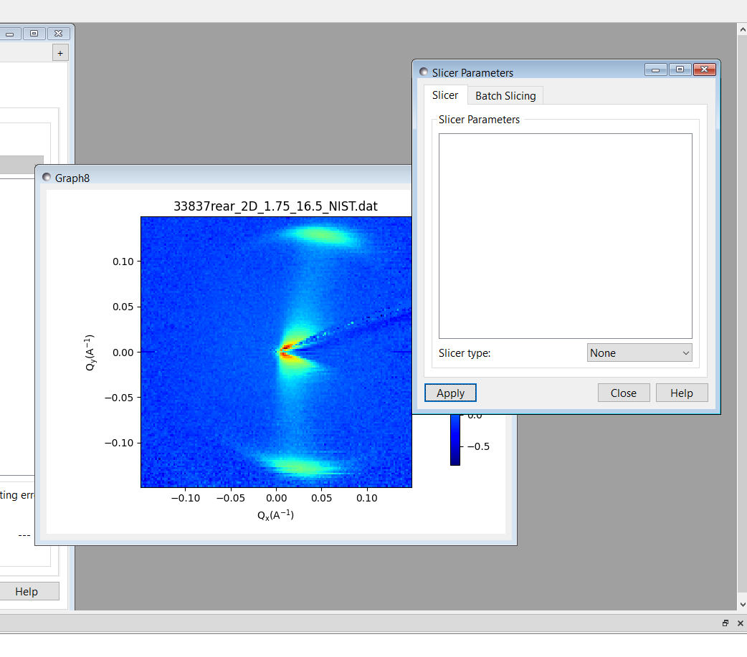
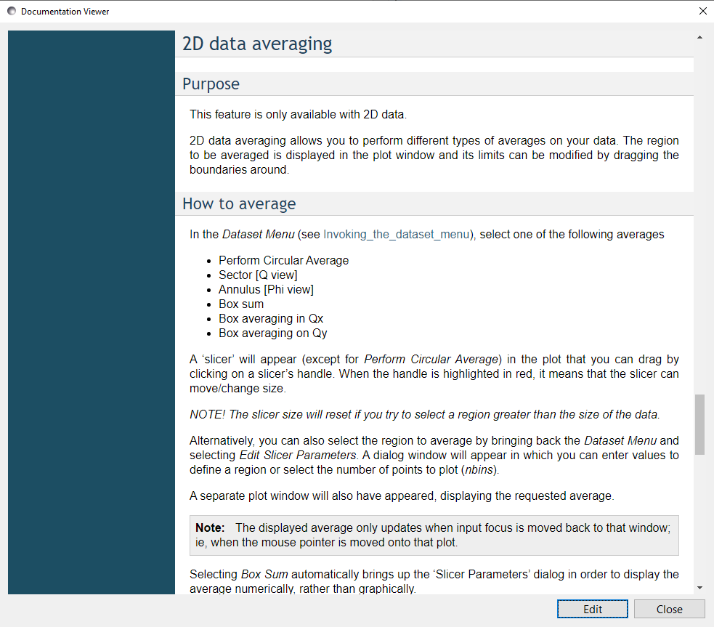
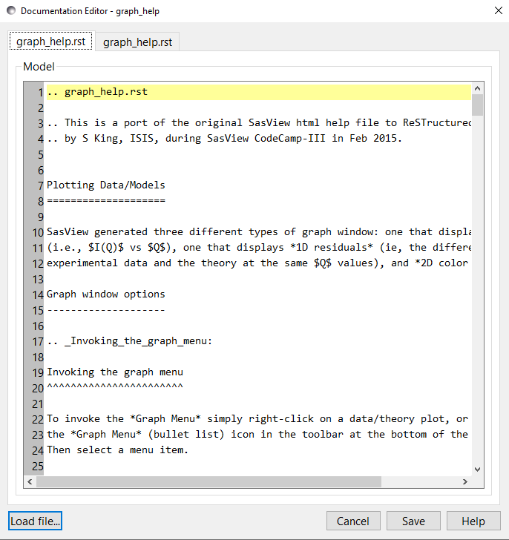
Implementation
Help Button Pressed
Edit Button Pressed
Save Button pressed

Slide 12

Working locally
ci.yml (Github Actions)
Makefile
gentoc.py
genmodel.py
Sphinx
(via command line)
RST Files
..\model\*.rst
HTML Files
..\_build\html

Slide 13
Working locally
ci.yml (Github Actions)
Replaced functionality of current GitHub actions to compile
Reduced runtime of GitHub processes
Avoided using new dependencies
Makefile
gentoc.py
genmodel.py
Sphinx
(via command line)
RST Files
..\model\*.rst
HTML Files
..\_build\html

Slide 14
Summary
Accomplishments:
Allow users to edit documentation locally
Create opportunities for crowdsourcing SasView
Documentation for community models is now visible
Bonus:
Math will display regardless of browser settings
Future work:
Automatic submission of edits to documentation
Documentation regeneration scripts can be optimized
Math still needs internet connection to display correctly

Slide 15
Special Thanks
Dr. Paul Butler
Paul Kienzle, Jeff Krzywon, Dr. Yun Liu, Dr. William Ratcliff
SHIP Program Sponsors:
Dr. Julie Borchers, Dr. Leland Harriger
And other SHIP Students

